Slide 1
EH&S Playbook TEC 406-160016
May 2021
Global Operations

Slide 2





Using this Playbook – What do the Icons Mean?
Where this Icon is visible refers to a Tip / help
Where this Icon is visible refers to a point of information on the subject, linking to additional Playbooks or Training materials for example
Where this Icon is visible refers to a special Note on the subject
Click on the House Icon to return to the TEOA House page
Click on the agenda icon to return to the agenda for the current phase
Return to Agenda

Slide 3


TEOA – Operations Management System
Key
PREMIER PARTNER FOR OUR CUSTOMERS
HIGHLY ENGAGED EMPLOYEES
Star Level Criteria
SUPERIOR RETURNS FOR OUR
SHAREHOLDERS
Transformational Tool
Balanced Scorecard (KPIs)
Operational Excellence (Lean)
Transformation
Technical Excellence
(COE)
Prepare
Diagnose & Design
Define Value & Design Future State
Implement
Create Flow & Pull
Sustain
Pursue Perfection
Strategy Alignment
Built in Quality ( Problem Solving MP, QCPC)
Opportunity to TE Best
Standard Work
Process Excellence Frameworks
Quick Changeover (EPEI)
Ready to Deploy Projects
Workplace Design (Cell Design & 3P)
Value Stream Management
(Material and Master Planning)
Technical Academies
Define Strategy and Develop Talent
Create Stability & Culture (EH&S, Quality Foundations, 5S& Visual Management, TPM, PIM)
Notes:
PIM is a Fundamental tool which starts in the Create Stability & Culture section of the House

Slide 4
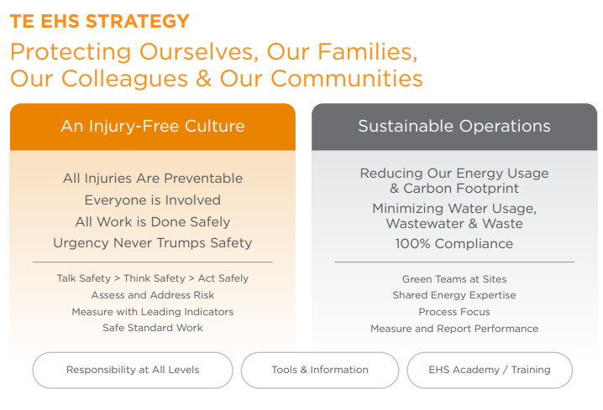
EH&S (Environment, Health and Safety)
Creating an injury free culture, EH&S compliance and sustainable operations.

Slide 5

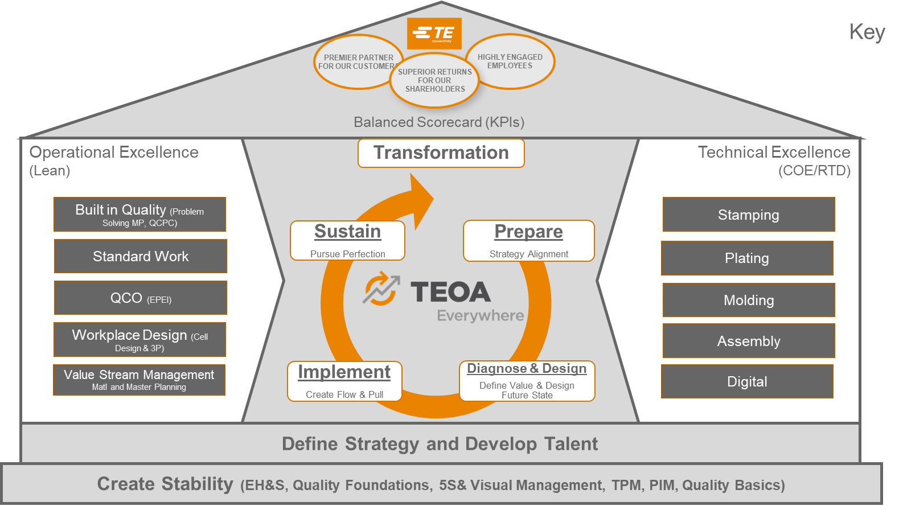
EH&S Fundamentals - An Overview
The TE EH&S Leadership Manual describes how TE sites are expected to manage EH&S and the
components of our EH&S program. It covers roles and responsibilities, data reporting, our EH&S
programs, resource references, communication tools and training. There is a link to the Manual below.
Our existing sites should already have a well established and robust site EH&S program and have implemented a continuous improvement process. Note: Business Units and Segments may supplement the TE Corporate requirements.
TE sites that are new to the company may need to build and develop their program to meet TE’s expectations.
Playbook Contents
EH&S Roles and Responsibilities
EH&S Metrics, Reporting, Communications
Creating the Fundamentals of a TE EH&S Program:
Health & Safety
Environmental compliance
Sustainability
EH&S Resources
Continuous improvement
Click to open the
EHS Leadership Manual
Click on the Links in the Table of Contents above to access the topic.

Slide 6
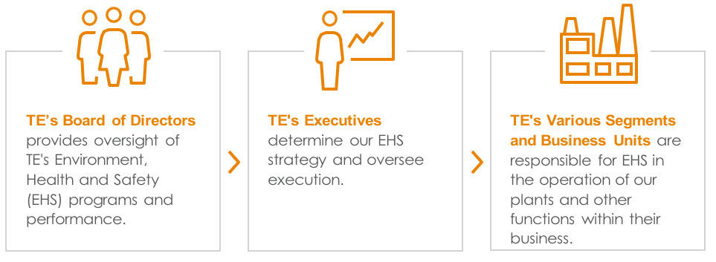
1. EH&S Roles and Responsibilities
The TE EH&S Leadership Manual describes EH&S roles and responsibilities and specifically says that:
Plant Managers own and are accountable for EH&S. Plant Managers are expected to set and execute the strategy for EHS at their location. They should employ competent EH&S staff to develop, assess and improve EH&S programs and performance, and provide support and resources for effective implementation of EH&S programs.
EH&S Staff provide EH&S expertise, monitor performance, identify needs and opportunities, address issues and implement programs, all in collaboration with operations leaders and others.
Return to Agenda

Slide 7
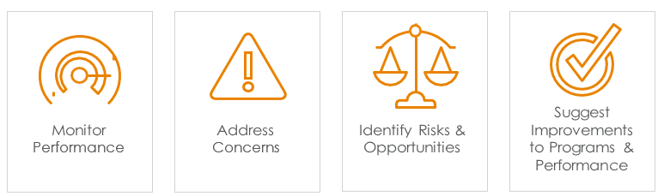

EH&S Staffing
A fundamental TE EH&S expectation is that sites have adequate trained staff to manage the site EH&S program, the number, experience and knowledge must be aligned to the site processes, size, risks and applicable regulations.
TE resources include guidance on how to determine EH&S staffing needs. These are available from the TE Corporate EH&S website.
The site EH&S leader should have access to and be accountable to the site leader, usually the Plant Manager.
Return to Agenda

Slide 8
2. EH&S Metrics, Reporting and Communications
Performance and progress in implementation of key programs are reported to TE executive and senior management at Corporate, Segment and Business Unit level. Each site is required to submit a number of metrics and reports, of these it is essential that any EH&S defects and significant matters or events are reported. The definitions of these requirements are found in the EH&S Leadership Manual.
EHS defects and significant matters
Safety: incidents and labor hours
Environmental metrics
Environmental compliance self-assessments
EH&S compliance audit corrective actions and completion
Safety Assessment for Effectiveness (S.A.F.E.) Scores
Annual Plant Manager EHS Letter
Note: The next slide refers to the Velocity EH&S Data Application, this application is used to document several of the metrics and reporting requirements listed above.
There are other EH&S communications the EH&S Leadership Manual covers that are key to a robust and effective EH&S program.
In addition to the above, Business Units and Segments may have additional metrics, reporting and communication requirements for their sites.
Click to open the
EHS Leadership Manual
Return to Agenda

Slide 9
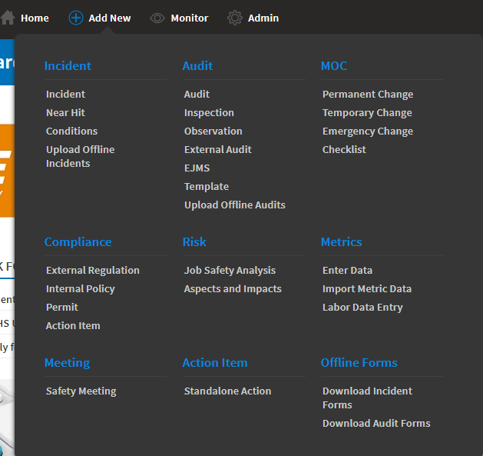
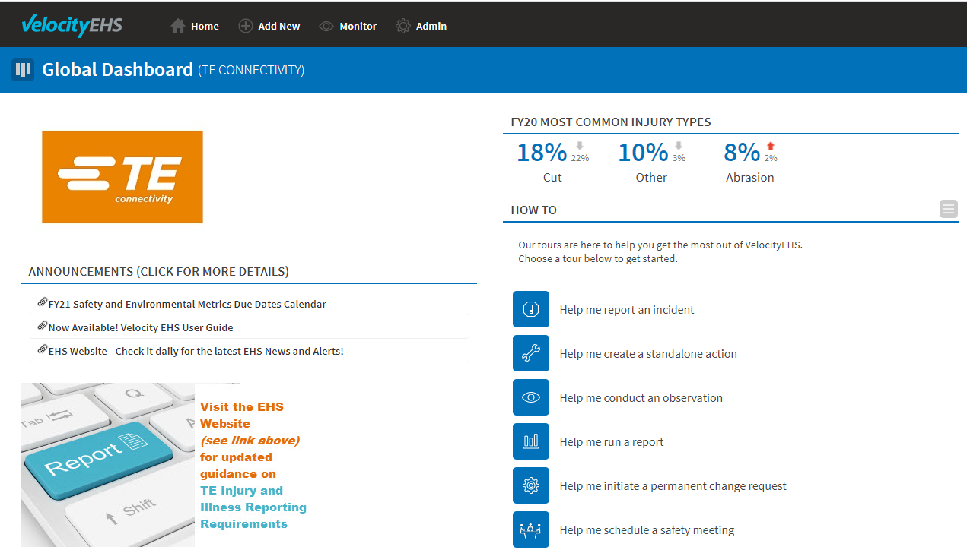
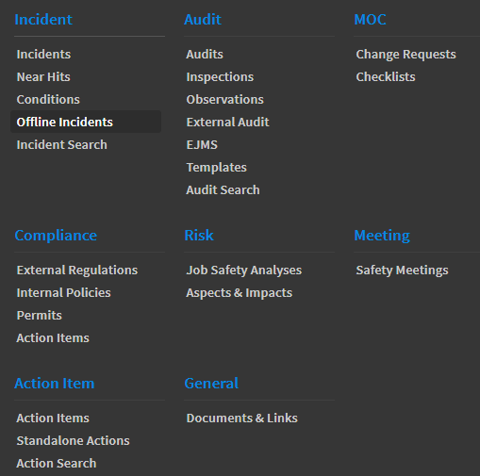
Velocity EH&S Data Application
The Velocity EHS application is used to document safety and environmental incidents, environmental metrics, compliance audits, self-assessments, and multiple EH&S processes at site, BU, and corporate levels.
Return to Agenda

Slide 10
3. Safety Fundamentals
Safety is a value. Site leadership demonstrates ownership of safety through word, action, and results. Risks are continuously assessed and the most effective controls are in-place. Employees are expected through the numerous opportunities provided to become involved in the safety program.
Leadership Structure – The site leader is responsible for the success of the safety program.
Compliance audits – Every 2-3 years plus ongoing site inspections and daily Gemba walks
Safety training programs – All employees receive quality safety training throughout the year.
Velocity EHS Data Application – Work hours and recordable injuries must be entered in the Velocity application along with completed accident investigations
EH&S Staffing – The site has the requisite number and quality of safety personnel requisite to the size and complexity of operations
PPE program – All personnel wear safety glasses with side shields at all times in all production areas. Other PPE that match specific hazards and risks is provided and worn as necessary.
S.A.F.E. – The site has conducted a baseline self-assessment in S.A.F.E. and has shown continuous improvement and advancement in scoring to the degrees expected by the business.
Return to Agenda

Slide 11
3. Environmental Compliance Fundamentals
We are committed to 100% compliance; it is critical to our license to operate and consequences for non-compliance can be severe, environmental harm is not necessary for regulatory action to be taken. Environmental compliance is managed so that performance is sustained. Site leadership demonstrates ownership of environmental compliance through word, action, and results.
TEOA tools are applied to environmental control equipment, waste and chemical storage areas, and environmental management/control processes where failures would directly or indirectly lead to non-compliance with environmental regulatory requirements.
E-Gemba walks are conducted routinely in all areas for environmental concern
Permit compliance plans are prepared, maintained, and implemented
The plant manager and the site EH&S leader have implemented a quarterly environmental compliance review process.
The site has qualified resources for operation and maintenance of pollution control systems.
Sites which are identified as higher environmental risk complete and regularly review and update the environmental compliance self-assessment modules.
Quarterly wastewater discharge certifications are completed as required.
Compliance audit findings are investigated to identify root causes and sustainable corrective actions are completed.
Return to Agenda

Slide 12
3. Sustainability Fundamentals
TE’s investors, customers, employees and others expect TE to be a sustainable company, This means doing our part to reduce the environmental impact of our operations, including but not limited to reducing our carbon footprint, energy and water usage, and waste generation
Energy reduction is fundamental to TE’s sustainability program – most of TE’s GHG emissions are the result of our use of energy (electricity and fuels).
Energy usage is reported regularly within TE and also annually reported externally with other sustainability metrics (GHG emissions, water and wastewater, waste, and recycled materials) in the TE CSR report, DJSI, and CDP.
Energy efficiency standards for core processes and infrastructure are implemented at the site.
Resources for energy management and reduction are available on the Energy SharePoint site.
Return to Agenda

Slide 13

4. EH&S Resources
TE provides a range of resources to support Plant Managers and EH&S staff, these are described in detail in the EH&S Manual and are listed below. We encourage you to use these and the EH&S community within TE, it is likely that most questions and issues you will face have been addressed somewhere in the company.
Corporate EH&S Website
Video Resources
EH&S Forum
Velocity EHS Database
Energy Website
EH&S Webinars
BU Product Compliance Representatives
LEARN@TE
Center of Excellence (CoE) Teams
Segment and Business Units may also have additional resources and websites for their sites..
Return to Agenda

Slide 14
Questions to Consider around EH&S Deployment
Beginning & Stabilised
Reference for details: Guidance for EHS Foundation Assessment
Does the site have?
A comprehensive safety & health management system that includes the elements found in SAFE.
A comprehensive environmental compliance management system that includes the elements listed in the environmental compliance tool.
An energy reduction management process, including improvement plans and resources to achieve targets.
Beginning
Cycles of Improvement
The expectation is the site will improve their SAFE score, sustain environmental
compliance & continuously reduce their carbon footprint.
Return to Agenda

